Slide 1


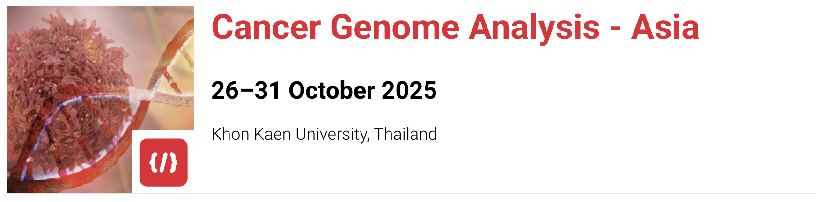
Introduction to the course

Slide 2
What is cancer?

Slide 3
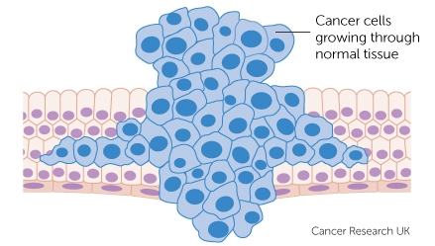

Slide 4
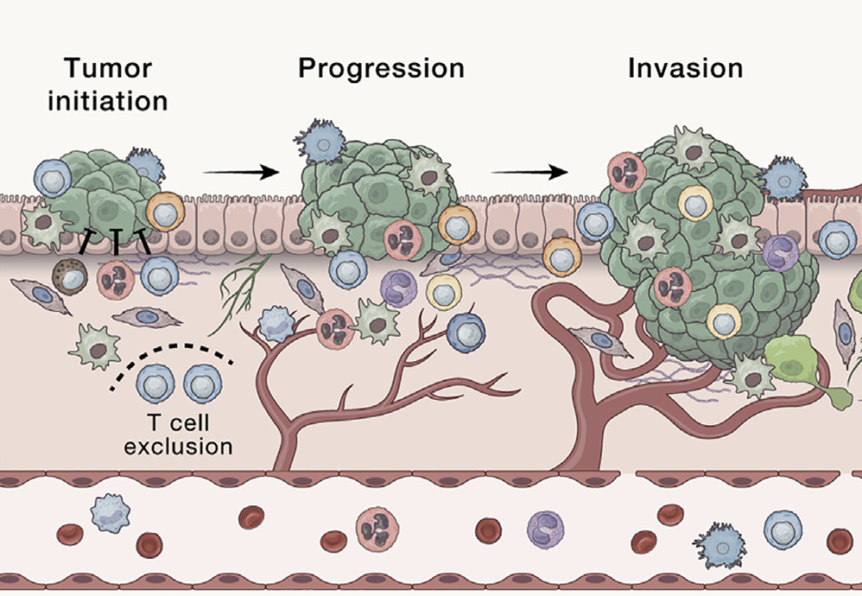
Cancer develops as cells acquire mutations
Mutation
De Visser and Joyce (2023)

Slide 5
Cancer develops as cells acquire mutations
Mutation
Increased growth
Altered cell cycle
Abnormal telomere regulation
De Visser and Joyce (2023)

Slide 6
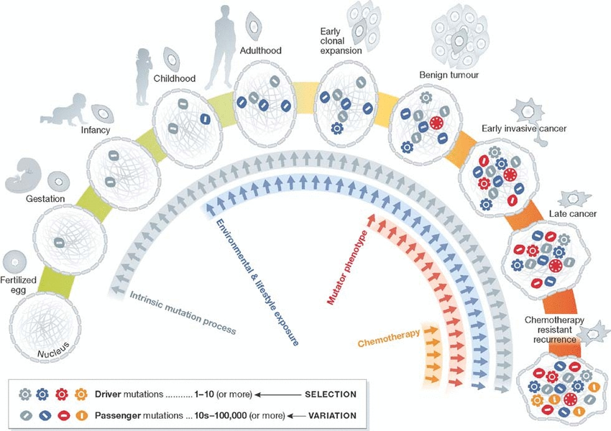
The acquisition of mutations is a life-long process
Stratton (2013)
Notes:
Aunuqe son muy confiables, dado qeu deben poder guardar información por periodos de tiempo muy muy largos, los genomas no son entidades completamente estables, y hay muchos factores tanto en el ambiente como dentro del cuerpo que pueden inducer cambios. Cuando nacemos, el ovulo fecundado tiene un genoma, que es la mezcla de los genomas del padre y la madre.

Slide 7
The acquisition of mutations is a life-long process
Stratton (2013)
Notes:
Sin embargo, dentro de las mismas células y el organism puede haber algunos procesos que causan mutaciones, por ejemplo con el tiempo algunas bases del genoma se convierten en otras por procesos naturales

Slide 8
The acquisition of mutations is a life-long process
Stratton (2013)
Stratton (2013)
Notes:
Mientras el organism continua viviendo, su estilo de vida como fumar o exponerse a los rayos ultravioleta Tambien puede inducer mutaciones

Slide 9
The acquisition of mutations is a life-long process
Stratton (2013)

Slide 10
The acquisition of mutations is a life-long process
Stratton (2013)

Slide 11
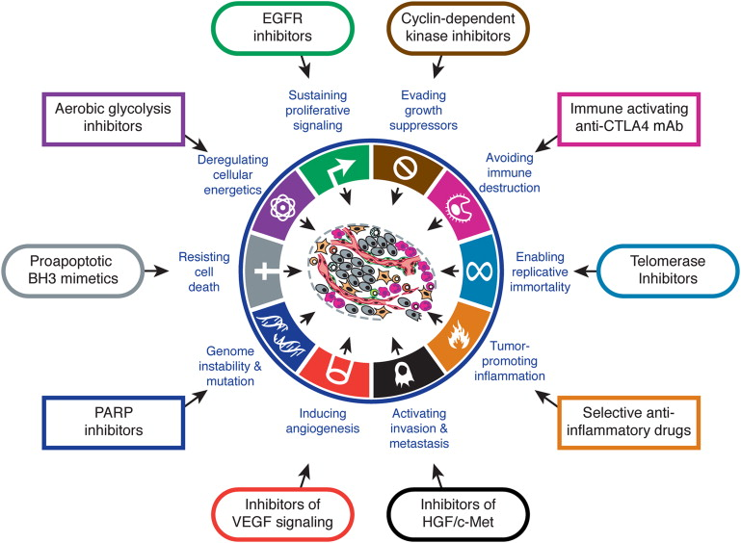
Mutations facilitate the acquisition of cancer hallmarks
Hanahan and Weinberg (2011)

Slide 12
Targeting these hallmarks can lead to effective treatments
Hanahan and Weinberg (2011)

Slide 13
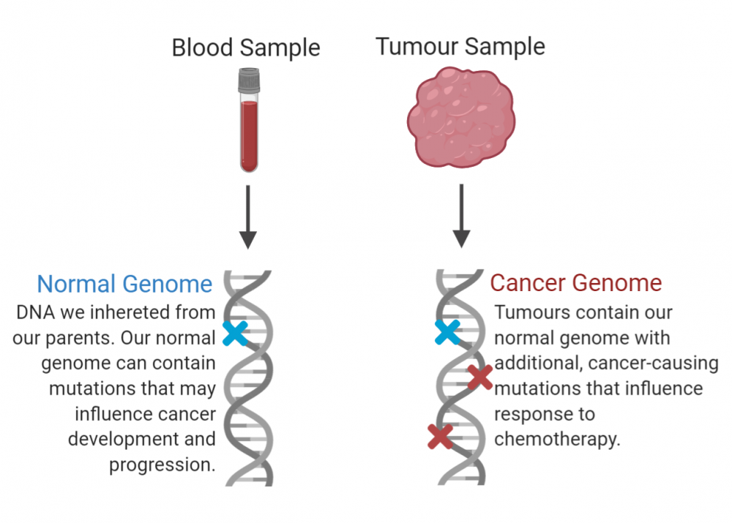
The study of genomes can help us identify the processes that fuel cancer development
Normal tissue sample
(typically blood or saliva)
Tumour tissue sample
BC Cancer Research Institute

Slide 14
The study of genomes can help us identify the processes that fuel cancer development
Normal tissue sample
(typically blood or saliva)
Tumour tissue sample
BC Cancer Research Institute

Slide 15
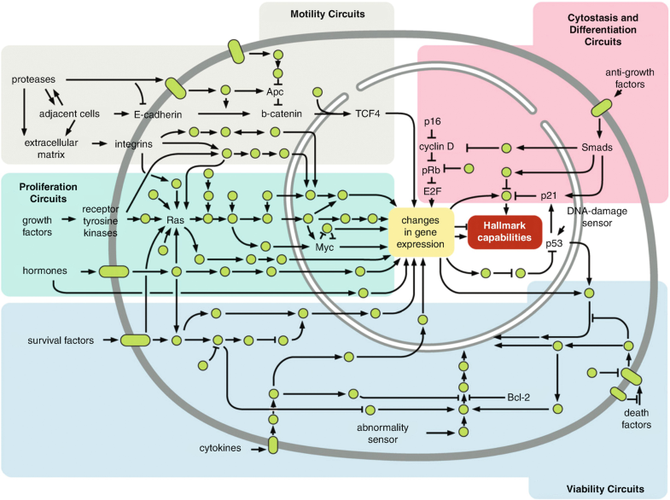
The study of genomes can help us identify the processes that fuel cancer development
Normal tissue sample
(typically blood or saliva)
Tumour tissue sample
BC Cancer Research Institute
Hanahan and Weinberg (2011)

Slide 16
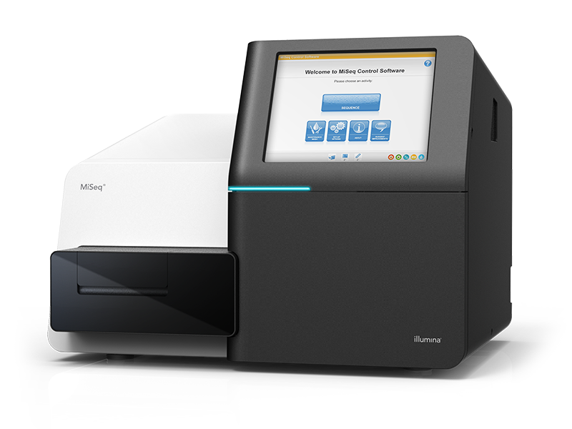
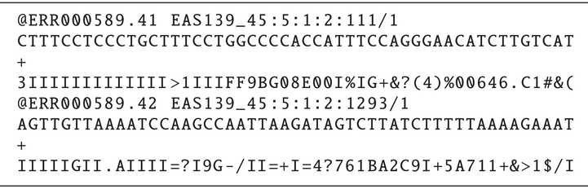
Studying the genome
Normal tissue sample
(typically blood or saliva)
Tumour tissue sample
Illumina
BC Cancer Research Institute

Slide 17


Studying the genome
Normal tissue sample
(typically blood or saliva)
Tumour tissue sample
Illumina
BC Cancer Research Institute

Slide 18
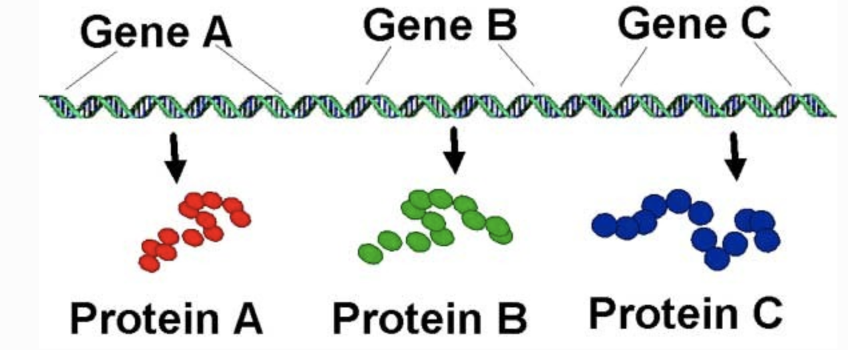
Studying the genome
Normal tissue sample
(typically blood or saliva)
Tumour tissue sample
Illumina
Actionable mutations
Driver genes
Patterns of mutations
D Lee
BC Cancer Research Institute

Slide 19
Studying the genome
Normal tissue sample
(typically blood or saliva)
Tumour tissue sample
Illumina
Actionable mutations
Driver genes
Patterns of mutations
D Lee
This course!
BC Cancer Research Institute

Slide 20
Topics we will cover
Data formats and QC
Mutation calling
Identifying gene drivers
Mutational signature analysis
RNA deconvolution
How do I interpret sequencing and mutation files?
How do I know if my data looks good?

Slide 21
Topics we will cover
Data formats and QC
Mutation calling
Identifying gene drivers
Mutational signature analysis
RNA deconvolution
How do I identify mutations in my sequencing data?
How do I know this is a good quality set of mutations?

Slide 22
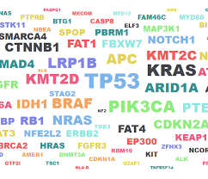
Topics we will cover
Data formats and QC
Mutation calling
Identifying gene drivers
Mutational signature analysis
RNA deconvolution
How do I identify which genes are driving the cancer I’m studying?

Slide 23


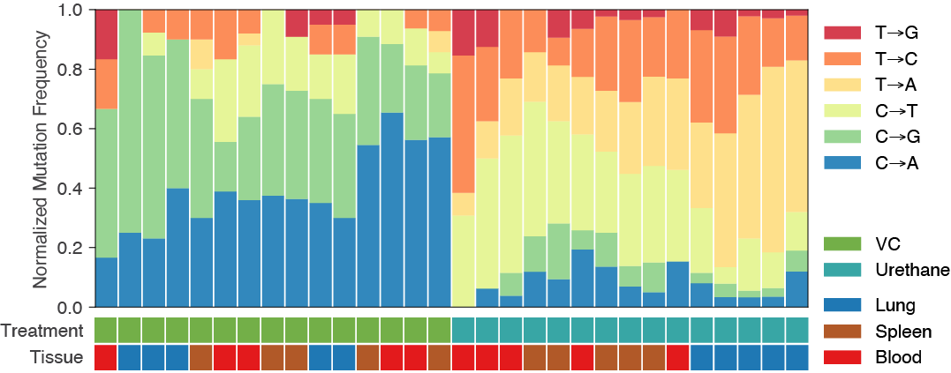
Topics we will cover
Data formats and QC
Mutation calling
Identifying gene drivers
Mutational signature analysis
RNA deconvolution
Mutation
proportion
Tumours
How do I identify patterns of mutations in my samples?
How do I associate them to etiological factors?

Slide 24
Topics we will cover
Data formats and QC
Mutation calling
Identifying gene drivers
Mutational signature analysis
Special sessions: Clinical
challenges and the role of genomics, tumour board
Mutation
proportion
Tumours
How is genomics used to guide clinical decisions?

Slide 25
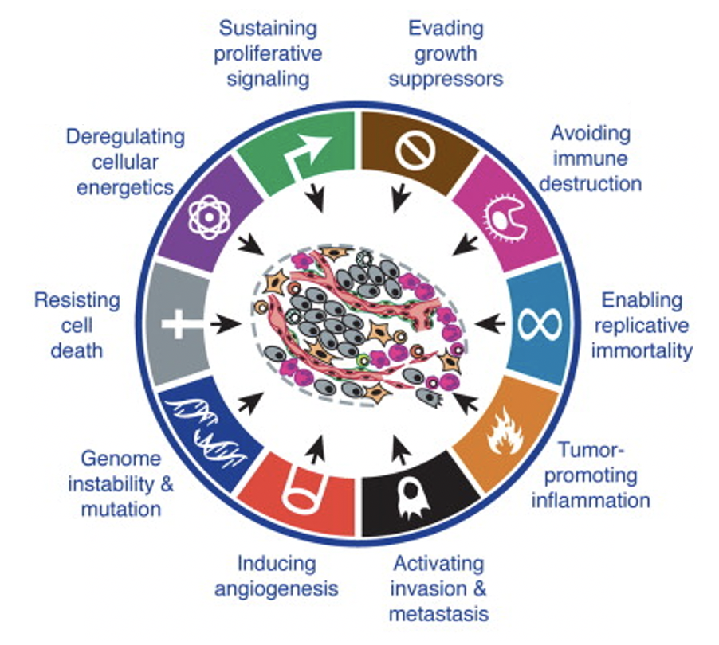
Cancer develops as cells acquire mutations
Mutation
Increased growth
Altered cell cycle
Abnormal telomere regulation
DAY 2:
Identification of mutations
DAY 4:
Identification of potential etiological factors
DAY 3:
Identification of driver genes
THROUGHOUT:
How does this inform clinical decisions?
De Visser and Joyce (2023)

Slide 26
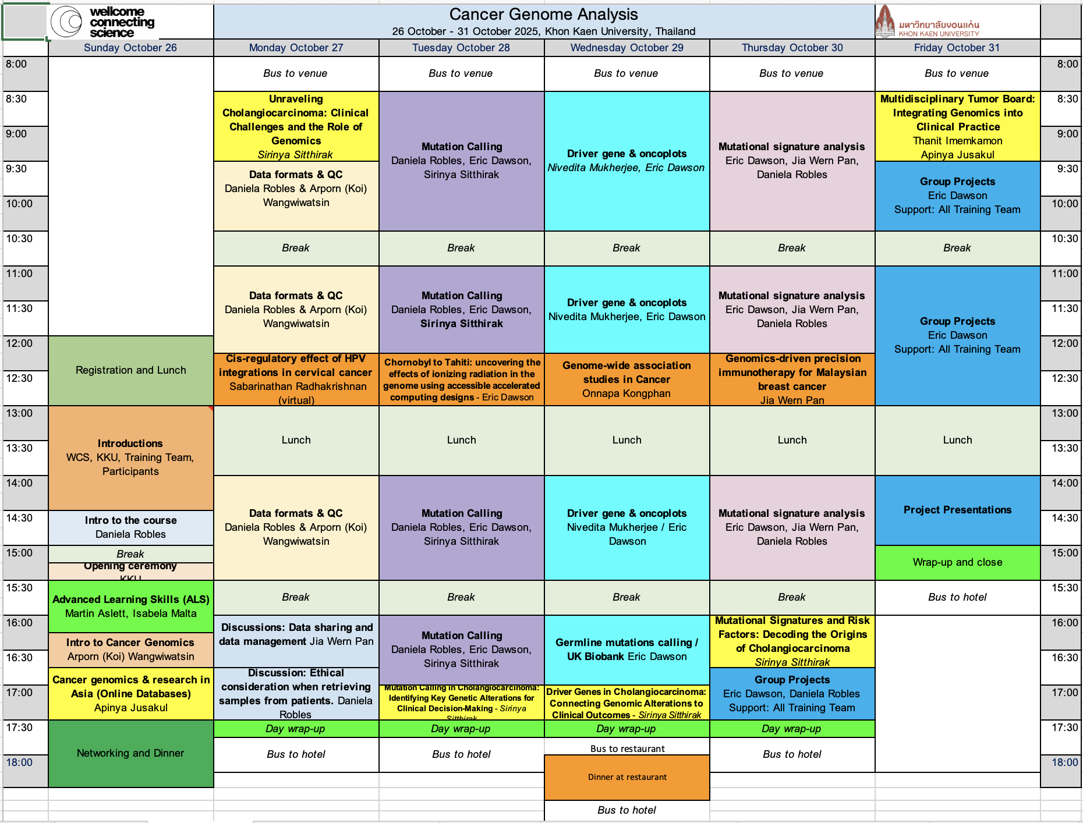
Topics we will cover

Slide 27
Seminars on cancer genomics and related work in Latin America
Sabarinathan Radhakrishnan (India)
Eric Dawson (USA)
Onnapa Kongphan (Thailand)
Jia Wern Pan (Malaysia)

Slide 28
Training on Advanced Learning
Martin Aslett and Isabela Malta (WGCAC, UK)

Slide 29
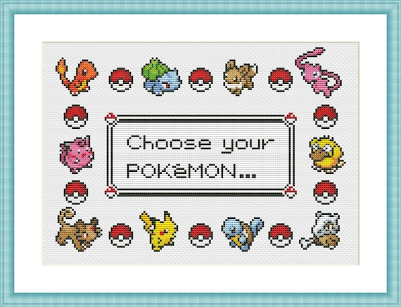
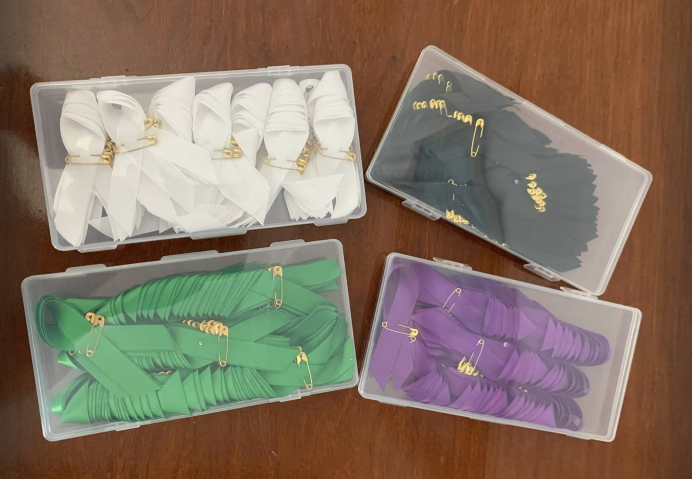
Group projects
Melanoma
Lung
Pancreatic
Liver
Marcos Díaz Gay

Slide 30
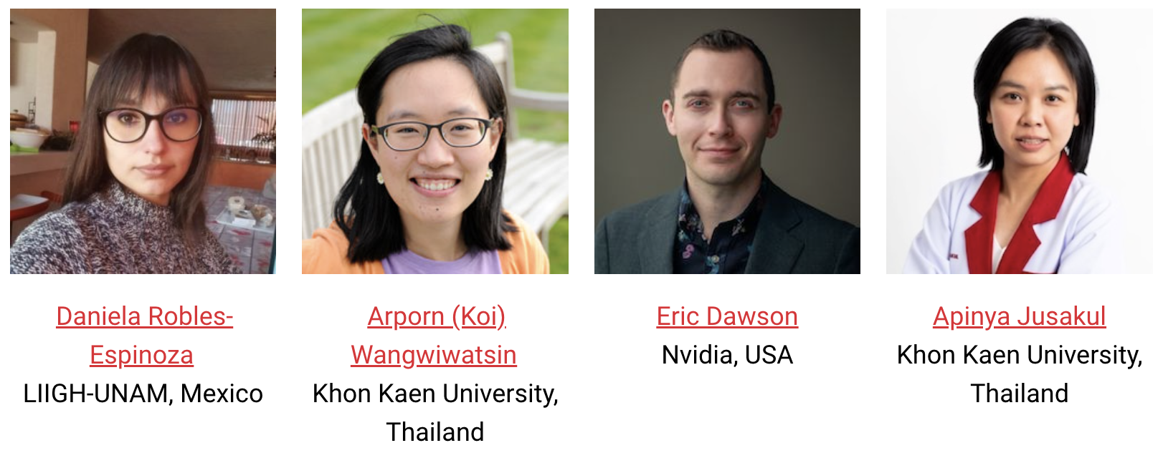
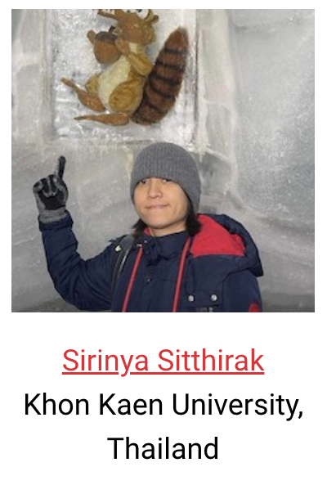
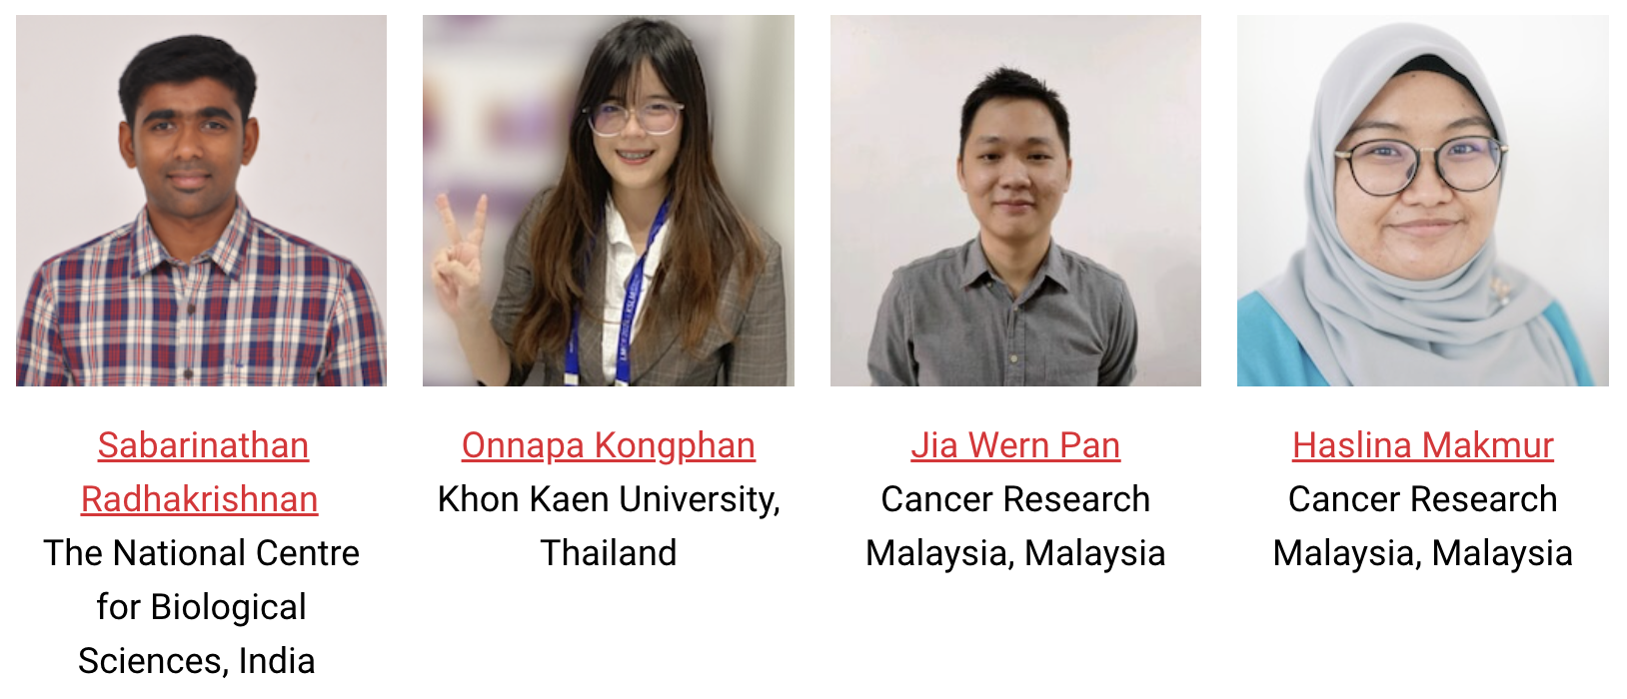
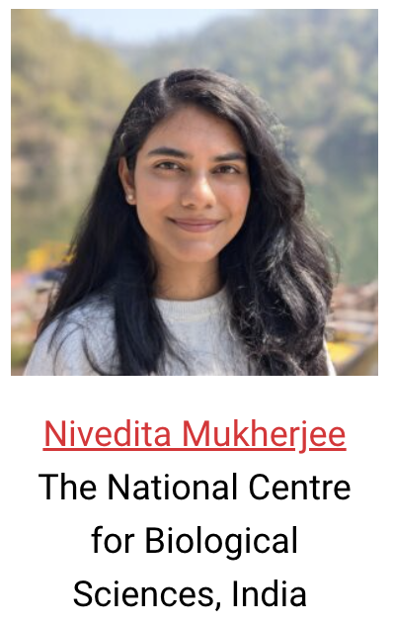
Training
team
EarthFrame, Corp.
Phileal, LLC

Slide 31
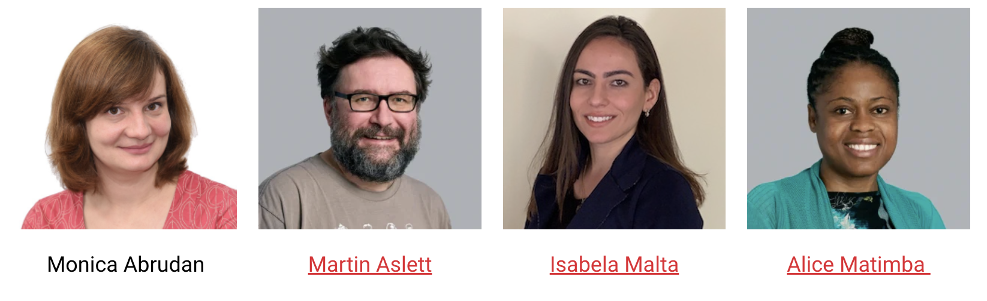
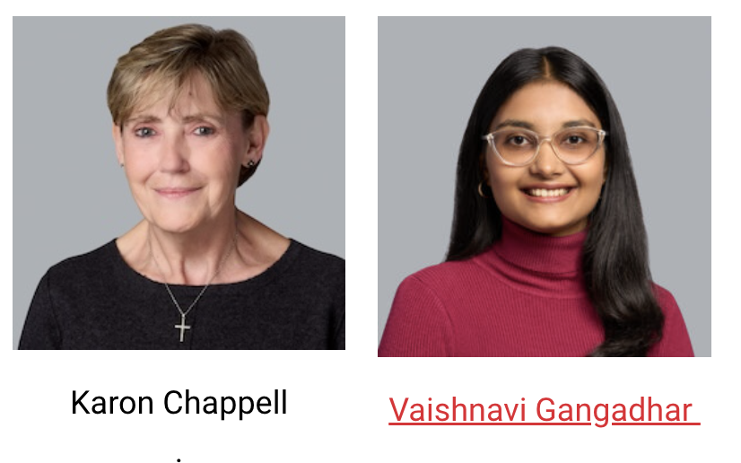
Organisers

Slide 32


